Slide 1
Berlin Demographics
Sarah Maged, Ana Cañizares
05/07/2025

Slide 2

Project Overview
Origin of dataset:
Residents registered in Berlin as their main place of residence
Source: Berlin-Brandenburg Statistical Office, published on 02/2025
Business case:
As a member of the Senate Department for Finance of Berlin
I want to draft a budget plan, including allocations for social services
so that citizen support is tailored to nationality, age, and marital status.
Hypotheses:
Among Berlin citizens, a higher percentage of Germans than foreigners are divorced.
Among Berlin citizens, the percentage of those aged 65 or over is higher for Germans than for foreigners of all ages.

Slide 3
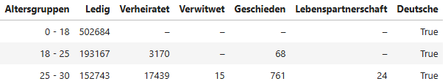

Data Acquisition, Enrichment & Examination
Challenges during cleaning with Python:
Handling null values: replacing – values (non null) with 0 in number of citizens.
Dropping rows: No rows were removed, and minors (0-18) were not filtered out despite all being single.
Manipulating strings: Renamed German values to translate them.
Pivoting: Used melt function to reshape df into a long format, added “German” TRUE / FALSE column.

Slide 4
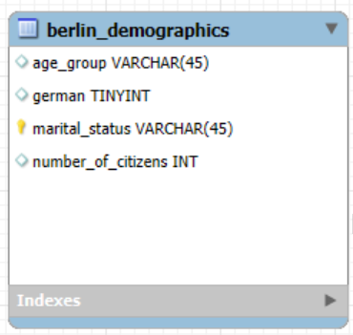
Database Design & Data Transformation
Entity-Relational-Model: Data types of columns were modified in EER diagram after table import.
Issue: German number format on CSV caused errors (dots as thousand separators).
Problem: Inaccurate number outputs in SQL queries.
Solution: Adjusted number formatting for correct outputs.
Visualizations (output SQL queries, pie charts on Google Sheets)

Slide 5
SQL Insights & Analysis
Insights from advanced SQL queries:
Creating a complex query with calculated columns (percentages of population) >SELECT SUM(number_of_citizens) * 100 / SUM(total_population) AS percentage_of_65_older
Challenging or revealing analysis:
Clean and prepare the data. Select the right type for each column.
Wouldn’t formulate complex hypothesis that have to be changed. Marital status + Nationality + Age

Slide 6

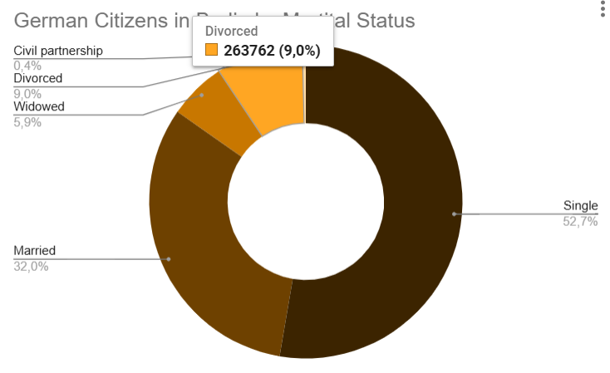
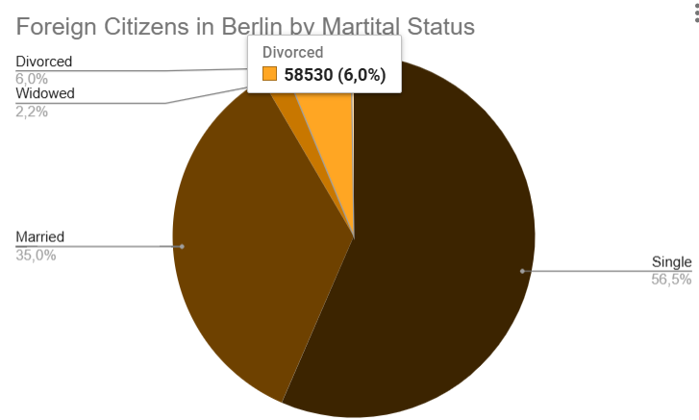
Hypothesis 1: Divorced Population
Among Berlin citizens, a higher percentage of Germans than foreigners are divorced.
The prevalence of divorce among the German population is 9%, while the rate among foreign citizens of Berlin is 6%.
Insight: it shows the distribution of marital status among Germans and non-Germans.
Conclusion: Hypothesis is true.

Slide 7

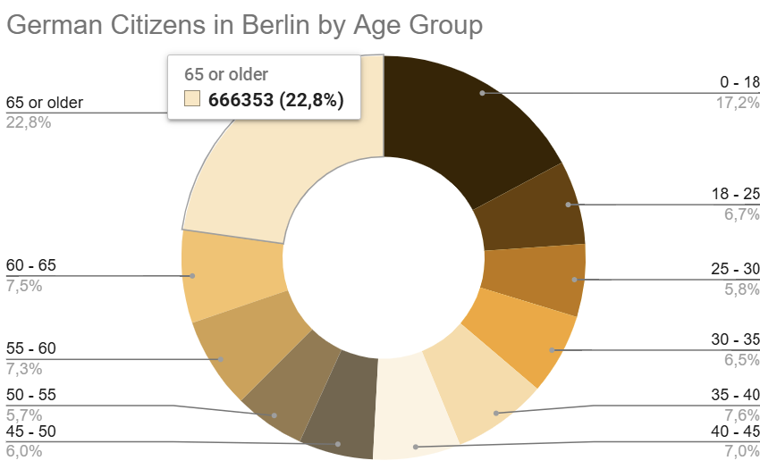
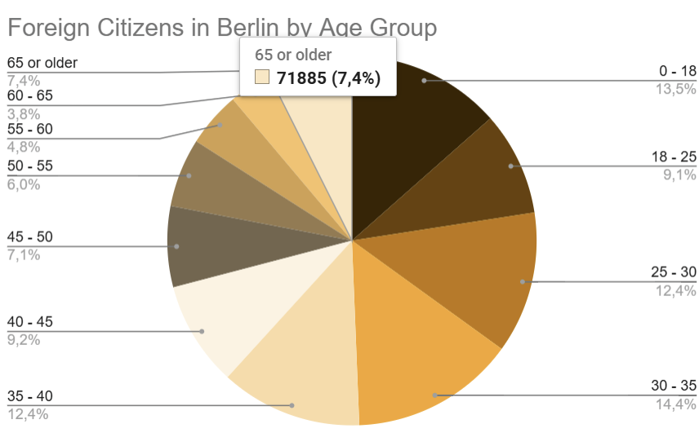
Hypothesis 2: Elderly Population
Among Berlin citizens, the percentage of those aged 65 or over is higher for Germans than for foreigners of all ages.
Charts: % of citizens aged 65 among Germans (top) & foreigners (bottom)
Insight: Germans 65+ make up 22.80 %, 3 times as many as foreigners 65+ (7.40 %).
Conclusion: Hypothesis is true.

Slide 8
Conclusions & Potential Implications
Higher Divorce Rate Among Germans The analysis confirms that a higher percentage of Germans in Berlin are divorced compared to foreigners.
Implications:
Social services such as legal aid
Counseling, and housing support may need greater allocation for German citizens, particularly in districts with higher divorce rates.
Aging Population Is Mostly German The majority of citizens aged 65 and older are German, while the foreign population is largely younger.
Implications:
Budget planning should account for age-related services (e.g., healthcare, elderly care, pensions) being more in demand among Germans.
Integration and employment programs may be prioritized for the younger, foreign population.

Slide 9
Major Obstacle
MySQL Workbench:
CSV imported with columns with blank spaces (cleaned them in Python / Google Sheets
CSV imported with numbers with dots in them (cleaned)
Would we do anything differently in hindsight?
Work more on the cleaning of the data in Jupyter and not in Excel

Slide 10
Demo (Files in Repository)
Thank you!
Berlin Demographics
Sarah Maged, Ana Cañizares

